Slide 1
Back to the Future
A Tribute to 80s Movies & Hope that Life Returns to Normal Sooner Rather than Later
By: Anirban Basu
Sage Policy Group, Inc.
On Behalf of
MEDA
September 22nd, 2020
Your Latest COVID-19 Economic Update

Slide 2
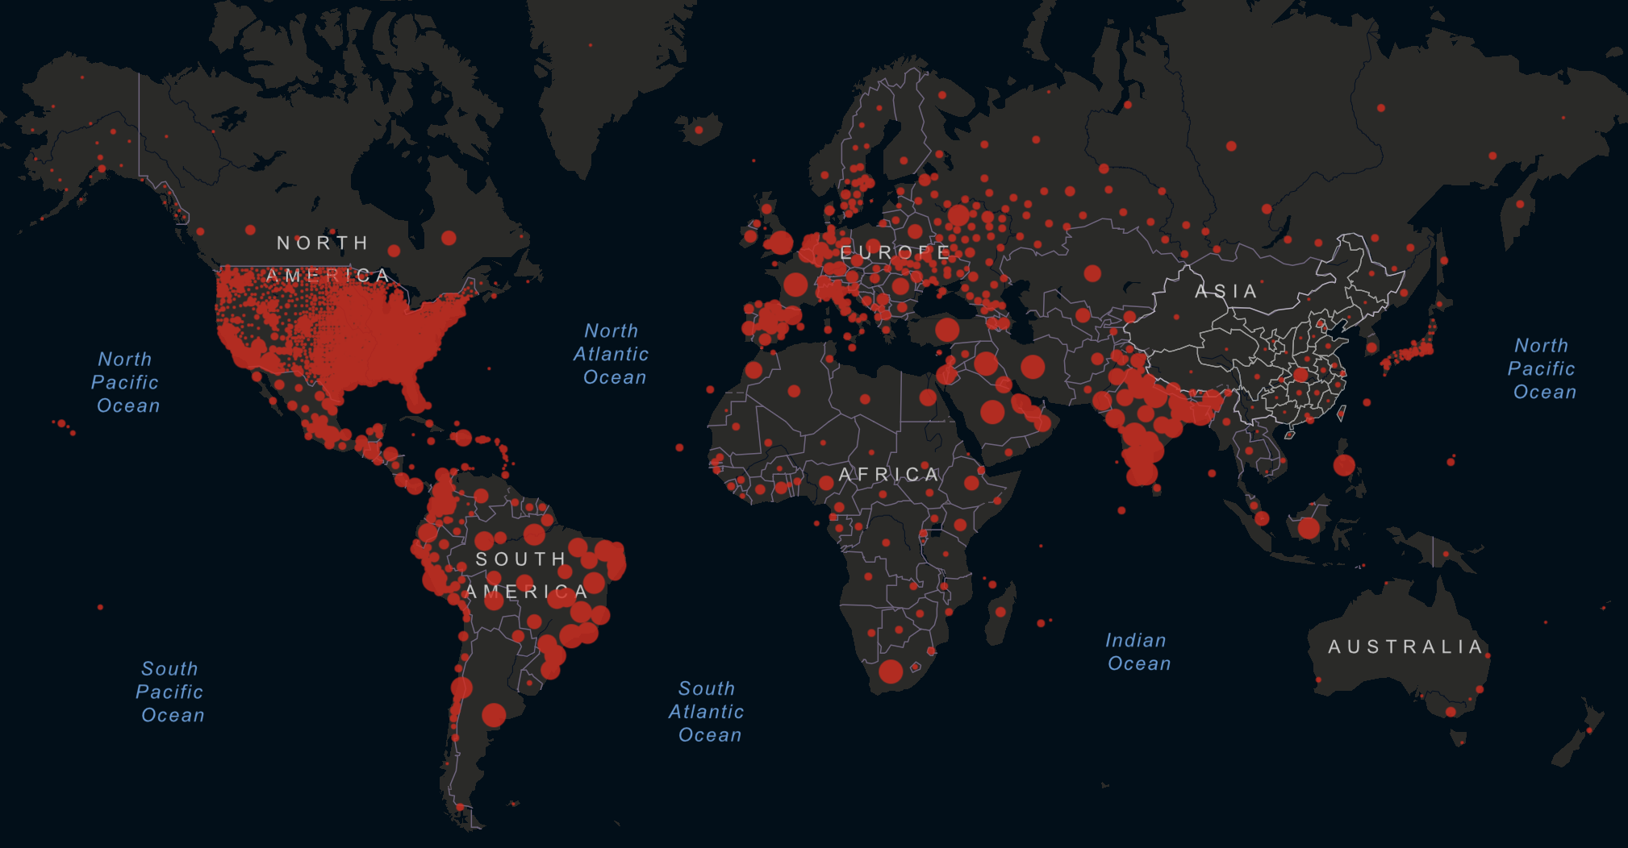
Coronavirus COVID-19 Global Cumulative Confirmed Cases
As of 9/21/2020
Total Confirmed: 31,089,558 | Total Deaths: 961,273
Source: Johns Hopkins University, Center for Systems Science and Engineering (CSSE)
Notes:
https://www.arcgis.com/apps/opsdashboard/index.html#/bda7594740fd40299423467b48e9ecf6

Slide 3
U.S. COVID-19 Daily Cases, March – September 2020
Source: The Covid Tracking Project
Notes:
https://covidtracking.com/data/charts/us-daily-positive
https://covidtracking.com/data/us-daily

Slide 4
Which Workers Face the Highest Unemployment Risk?
 | Total Employment | Share of Total Employment
All Occupations | 144,731,220 | -
Employed in Occupations at “Low Risk” of Layoff | 77,944,910 | 54%
Employed in “Essential” Occupations | 24,840,280 | 17%
Employed in Occupations Possible to Work from Home | 48,204,920 | 33%
Employed in Other Salaried Occupations | 4,899,710 | 3%
Employed in Occupations at “High Risk” of Layoff | 66,786,310 | 46%
Food Preparation and Serving-Related Occupations | 13,374,170 | 9%
Sales and Related Occupations | 10,443,460 | 7%
Production Occupations | 8,313,750 | 6%
Installation, Maintenance and Repair Occupations | 5,628,890 | 4%
All Other “High-Risk” Occupations | 29,026,040 | 20%
Source: Charles Gascon, "COVID-19: Which Workers Face the Highest Unemployment Risk?”, Federal Reserve Bank of St. Louis, 3/24/2020.
Notes:
https://www.stlouisfed.org/on-the-economy/2020/march/covid-19-workers-highest-unemployment-risk?utm_source=twitter&utm_medium=SM&utm_content=stlouisfed&utm_campaign=c5199a6d-16ae-49b4-a5fa-1cd4542b8be1

Slide 5
Gross Domestic Product
1990Q2 through 2020Q2*
Source: U.S. Bureau of Economic Analysis *2nd Estimate

Slide 6
Ferris Bueller's Day Off (1986)

Slide 7
U.S. Unemployment Insurance Initial Weekly Claims, 2019-2020
During the week ending September 12th, the advance figure for seasonally adjusted initial claims was 860,000, a decrease of 33,000 from the previous week.
But that’s not the whole story . . .
Source: U.S. Department of Labor, Employment & Training Administration
Notes:
https://oui.doleta.gov/unemploy/claims_arch.asp
Initial Claims: https://fred.stlouisfed.org/series/ICSA
Continued Claims (Insured Unemployment): https://fred.stlouisfed.org/series/CCSA
4-Week Moving Average of Continued Claims (Insured Unemployment): https://fred.stlouisfed.org/series/CC4WSA
**REVISION TO SEASONAL ADJUSTMENT FACTORS Beginning with the Unemployment Insurance (UI) Weekly Claims News Release issued Thursday, September 3, 2020, the methodology used to seasonally adjust the national initial claims and continued claims will reflect additive factors as opposed to multiplicative factors. Seasonal adjustment factors can be either multiplicative or additive. A multiplicative seasonal effect is assumed to be proportional to the level of the series. A sudden large increase in the level of the series will be accompanied by a proportionally large seasonal effect. In contrast, an additive seasonal effect is assumed to be unaffected by the level of the series. In times of relative economic stability, the multiplicative option is generally preferred over the additive option. However, in the presence of a large level shift in a time series, multiplicative seasonal adjustment factors can result in systematic over- or under-adjustment of the series; in such cases, additive seasonal adjustment factors are preferred since they tend to more accurately track seasonal fluctuations in the series and have smaller revisions. Prior to September 2020, the seasonally adjusted unemployment insurance claims series used multiplicative seasonal adjustment factors. Starting in September Bureau of Labor Statistics staff, who provide the seasonal adjustment factors, specified these series as additive. In accordance with the usual practice, the seasonal adjustment models and factors will be reviewed at the beginning of each calendar year, when prior years of seasonally adjusted estimates will be subject to revision.

Slide 8
U.S. Unemployment Insurance Continuing Claims, 2019-2020
During the week ending September 5th, the advance figure for seasonally adjusted insured unemployment was 12,628,000, a decrease of 916,000 from the previous week.
Continuing claims remain at the highest levels in the history of the seasonally adjusted series.
Source: U.S. Department of Labor, Employment & Training Administration
Notes:
https://oui.doleta.gov/unemploy/claims_arch.asp
Initial Claims: https://fred.stlouisfed.org/series/ICSA
Continued Claims (Insured Unemployment): https://fred.stlouisfed.org/series/CCSA
4-Week Moving Average of Continued Claims (Insured Unemployment): https://fred.stlouisfed.org/series/CC4WSA
**REVISION TO SEASONAL ADJUSTMENT FACTORS Beginning with the Unemployment Insurance (UI) Weekly Claims News Release issued Thursday, September 3, 2020, the methodology used to seasonally adjust the national initial claims and continued claims will reflect additive factors as opposed to multiplicative factors. Seasonal adjustment factors can be either multiplicative or additive. A multiplicative seasonal effect is assumed to be proportional to the level of the series. A sudden large increase in the level of the series will be accompanied by a proportionally large seasonal effect. In contrast, an additive seasonal effect is assumed to be unaffected by the level of the series. In times of relative economic stability, the multiplicative option is generally preferred over the additive option. However, in the presence of a large level shift in a time series, multiplicative seasonal adjustment factors can result in systematic over- or under-adjustment of the series; in such cases, additive seasonal adjustment factors are preferred since they tend to more accurately track seasonal fluctuations in the series and have smaller revisions. Prior to September 2020, the seasonally adjusted unemployment insurance claims series used multiplicative seasonal adjustment factors. Starting in September Bureau of Labor Statistics staff, who provide the seasonal adjustment factors, specified these series as additive. In accordance with the usual practice, the seasonal adjustment models and factors will be reviewed at the beginning of each calendar year, when prior years of seasonally adjusted estimates will be subject to revision.

Slide 9
Net Change in U.S. Jobs, August 2002 – August 2020
Source: U.S. Bureau of Labor Statistics
Notes:
US Total Nonfarm (SA): CES0000000001
U.S. Unemployment Rate LNS14000000

Slide 10
National Nonfarm Employment by Industry Sector, August 2019 v. August 2020
All told 10.2 million jobs lost
Source: U.S. Bureau of Labor Statistics

Slide 11
Maryland Nonfarm Employment by Industry Sector Groups (SA)
August 2019 v. August 2020 Absolute Change
MD Total: -175.8K; -6.4%
US Total (SA): -10.2M; -6.8%
*According to the Local Area Unemployment Statistics (LAUS) program
MD lost 129,479 jobs between August 2019 and August 2020.
Source: U.S. Bureau of Labor Statistics

Slide 12
Baltimore-Columbia-Towson MSA Nonfarm Employment by Industry Sector Groups (NSA)
August 2019 v. August 2020 Absolute Change
Baltimore MSA Total: -83.6K; -5.9%
MD Total (SA): -175.8K; -6.4%
US Total (SA):
-10.2M; -6.8%
Source: U.S. Bureau of Labor Statistics

Slide 13
Washington, DC-Arlington-Alexandria MSA Nonfarm Employment by Industry Sector Groups (NSA)
August 2019 v. August 2020 Absolute Change
DC MSA Total: -201.4K; -6.0%
US Total (SA): -10.2M; -6.8%
Source: U.S. Bureau of Labor Statistics

Slide 14
Unemployment Rates, 25 Largest Metros (NSA)
July 2020
Rank | MSA | % |  | Rank | MSA | %
1 | Baltimore-Columbia-Towson, MD | 7.5 |  | 12 | Tampa-St. Petersburg-Clearwater, FL | 10.1
1 | Dallas-Fort Worth-Arlington, TX | 7.5 |  | 14 | Phoenix-Mesa-Scottsdale, AZ | 10.3
3 | Denver-Aurora-Lakewood, CO | 7.8 |  | 15 | Portland-Vancouver-Hillsboro, OR-WA | 11.1
4 | San Antonio-New Braunfels, TX | 7.9 |  | 15 | San Francisco-Oakland-Hayward, CA | 11.1
4 | Washington-Arlington-Alexandria, DC-VA-MD-WV | 7.9 |  | 17 | Chicago-Naperville-Elgin, IL-IN-WI | 12.0
 |  |  |  | 18 | San Diego-Carlsbad, CA | 12.3
6 | Minneapolis-St. Paul-Bloomington, MN-WI | 8.2 |  | 19 | Miami-Fort Lauderdale-West Palm Beach, FL | 13.2
6 | St. Louis, MO-IL | 8.2 |  | 20 | Riverside-San Bernardino-Ontario, CA | 13.4
8 | Atlanta-Sandy Springs-Roswell, GA | 8.5 |  | 21 | Philadelphia-Camden-Wilmington, PA-NJ-DE-MD | 14.1
9 | Charlotte-Concord-Gastonia, NC-SC | 9.3 |  | 22 | Orlando-Kissimmee-Sanford, FL | 15.3
9 | Seattle-Tacoma-Bellevue, WA | 9.3 |  | 23 | Boston-Cambridge-Nashua, MA-NH | 15.5
11 | Houston-The Woodlands-Sugar Land, TX | 9.4 |  | 24 | New York-Newark-Jersey City, NY-NJ-PA | 16.4
12 | Detroit-Warren-Dearborn, MI | 10.1 |  | 25 | Los Angeles-Long Beach-Anaheim, CA | 16.8
U.S. Unemployment Rate
July: 10.2% August: 8.4%
Source: U.S. Bureau of Labor Statistics, Current Employment Statistics (CES) Survey
Notes:
NOTE: Could we spruce up the table/change the table colors?

Slide 15
Maryland Unemployment Rates by County
July 2020
Rank | Jurisdiction | % | Rank | Jurisdiction | %
1 | Carroll County | 5.8 | 13 | Wicomico County | 7.2
2 | Calvert County | 5.9 | 14 | Montgomery County | 7.4
2 | Caroline County | 5.9 | 14 | Washington County | 7.4
4 | Queen Anne's County | 6.0 | 16 | Dorchester County | 7.5
4 | St. Mary's County | 6.0 | 16 | Kent County | 7.5
6 | Howard County | 6.1 | 18 | Baltimore County | 7.8
7 | Talbot County | 6.3 | 19 | Charles County | 8.0
8 | Harford County | 6.6 | 20 | Allegany County | 8.1
9 | Anne Arundel County | 6.7 | 21 | Somerset County | 8.5
9 | Cecil County | 6.7 | 22 | Worcester County | 9.2
9 | Frederick County | 6.7 | 23 | Prince George's County | 9.5
12 | Garrett County | 6.9 | 24 | Baltimore City | 10.0
Maryland: 7.6%
Source: U.S. Bureau of Labor Statistics

Slide 16
U.S. Retail Sales, August 2000 – August 2020
Source: U.S. Census Bureau
Notes:
https://www.census.gov/retail/index.html

Slide 17
Economic Impact of Past Pandemics – This One Will be Worse
Goldman Sachs analyzed GDP changes during other pandemics, including the 2003 SARS episodes in China, Hong Kong, and Canada, the 1957 Avian Flu in the U.S., and the 2015 MERS episode in South Korea.
The average episode saw a GDP hit of 4-5% in the 1-2 quarters after the outbreak, though the variation was substantial.
Source: Goldman Sachs
Notes:
https://www.goldmansachs.com/insights/pages/top-of-mind/coronavirus/report.pdf

Slide 18
The Cure is Just Oh, So Different:
U.S. Government Legislative Actions
Phase 1 (3/6/2020)—Coronavirus Preparedness and Response Supplemental Appropriations Act: $8.3 billion in emergency funding.
Phase 2 (3/18/2020)—Families First Coronavirus Response Act: $192 billion
  Provided paid sick leave, tax credits, and free COVID-19 testing; expanded food assistance and unemployment benefits; and increased Medicaid funding.
Phase 3 (3/27/2020)—Coronavirus Aid, Relief, and Economic Security (CARES) Act: More than $2 trillion (expected to increase the deficit by $1.7 trillion)
  Direct payments to Americans; scaled up unemployment insurance program; loans and grants for small and large businesses and governments; aid to state and local governments, business tax cuts; other health and safety related spending provisions.
Phase 4 (4/24/2020)—Paycheck Protection Program and Health Care Enhancement Act: $483 billion
  Additional funding for Paycheck Protection Program, hospitals, testing efforts, and emergency disaster loans and grants.
Source: Congress.gov; Committee for a Responsible Federal Budget; NPR News
Notes:
http://www.crfb.org/blogs/covid-money-tracker-policies-enacted-to-date
http://www.crfb.org/papers/webinar-chartbook-unpacking-next-phase-covid-19-relief
http://www.crfb.org/blogs/whats-2-trillion-coronavirus-relief-package
https://www.npr.org/2020/03/27/822062909/house-aims-to-send-2-trillion-rescue-package-to-president-to-stem-coronavirus-cr
https://www.npr.org/2020/03/26/821457551/whats-inside-the-senate-s-2-trillion-coronavirus-aid-package
https://www.npr.org/2020/03/25/818881845/senate-reaches-historic-deal-on-2t-coronavirus-economic-rescue-package
https://www.cnn.com/2020/03/25/politics/stimulus-package-details-coronavirus/index.html

Slide 19
U.S. Restaurant Reservations (Seated Diners)
YOY % Change, February 2020 – September 2020
Source: Open Table
Notes:
https://www.opentable.com/state-of-industry
First, the overall impact of Covid 19 on the industry by showing year-over-year seated diners at a sample of restaurants on the OpenTable network across all channels: online reservations, phone reservations, and walk-ins. For year-over-year comparisons by day, we compare to the same day of the week from the same week in the previous year. For example, we’d compare Tuesday of week 11 in 2020 to Tuesday of week 11 in 2019. Only states or metros with 50+ restaurants on the OpenTable network for 2019 or 2020 are included in the sample. To better reflect the state of the industry overall, this dataset is based on a sample of approximately 20,000 restaurants that provide OpenTable with information on all of their inventory. This sample of restaurants typically accounts for a majority of our seated online reservations.

Slide 20
U.S. Unemployment Rate, August 2000 – August 2020
Source: U.S. Bureau of Labor Statistics
Notes:
LNS14000000
LNS14000001
LNS14000002

Slide 21
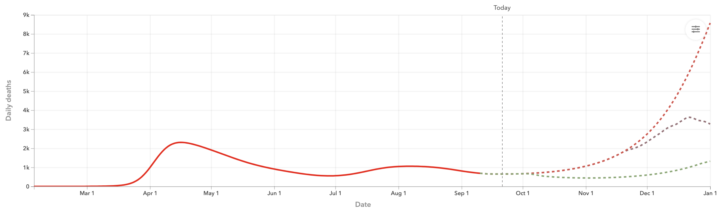
How Awful?
U.S. Projected Deaths Per Day Due to COVID-19
According to the Institute for Health Metrics and Evaluation, daily deaths is the best indicator of the progression of the pandemic, although there is generally a 17-21 day lag between infection and deaths.
Source: Institute for Health Metrics and Evaluation
Notes:
https://covid19.healthdata.org/united-states-of-america
https://www.bloomberg.com/graphics/2020-coronavirus-where-is-the-us-on-the-curve/

Slide 22
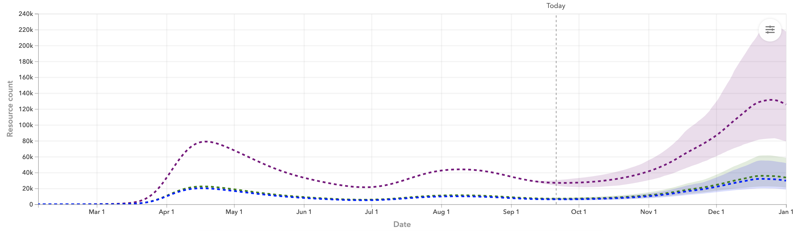
When Did it Peak?
U.S. Projected Hospital Resource Use
Source: Institute for Health Metrics and Evaluation
Notes:
https://covid19.healthdata.org/united-states-of-america
https://www.bloomberg.com/graphics/2020-coronavirus-where-is-the-us-on-the-curve/

Slide 23
U.S. Covid-19 Tests, January - September 2020
Source: The Covid Tracking Project
Notes:
https://covidtracking.com/data/us-daily

Slide 24

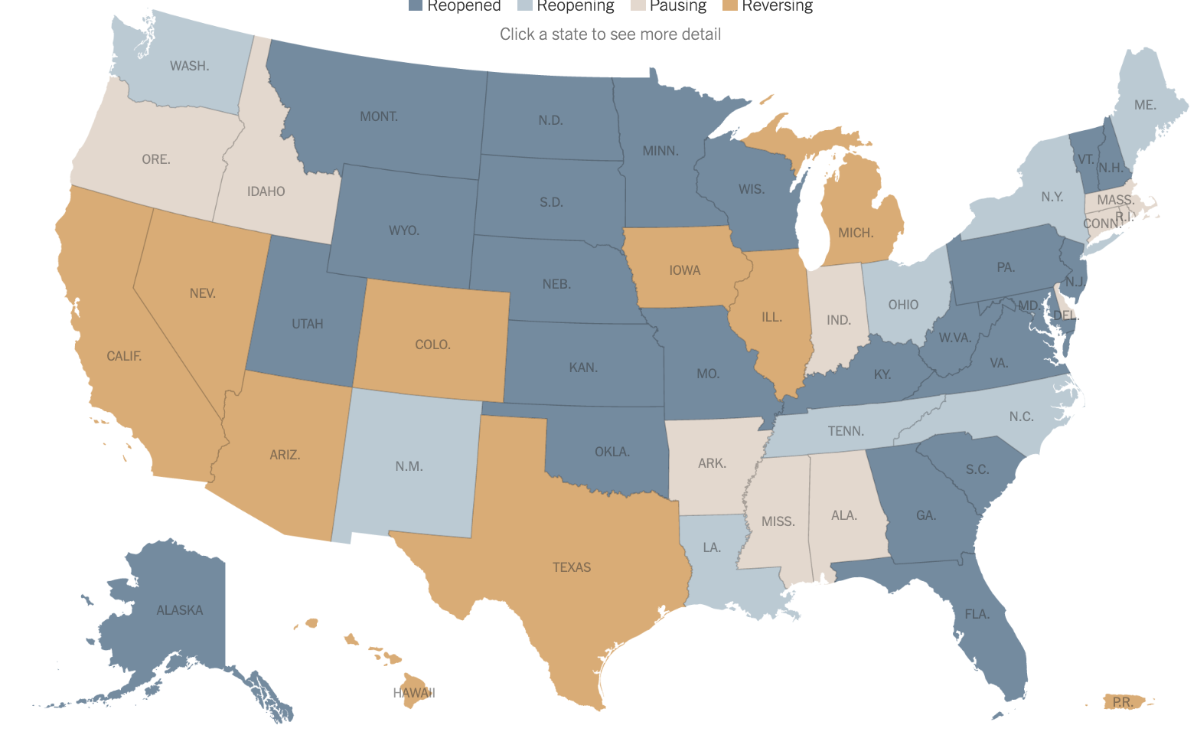
Which States Are Reopening & Which Are Closing Again
As of September 18th
Source: The New York Times
Notes:
https://www.nytimes.com/interactive/2020/us/states-reopen-map-coronavirus.html
https://www.bloomberg.com/graphics/us-states-reopening-coronavirus-tracker/
https://www.cnn.com/interactive/2020/us/states-reopen-coronavirus-trnd/

Slide 25
What Can Unite Us? A Vaccine!
Scientists are scrambling to develop a vaccine for Covid-19. More than ever before, pharma, biotechs, start-ups, research institutes and universities are working together to develop a vaccine and identify new therapies to treat symptoms of this disease.
On July 27th, Moderna’s vaccine candidate developed with NIH initiated Phase 3 efficacy testing. The plan is for up to 30,000 volunteers to participate in the trial.
According to the Milken Institute, there are currently 212 vaccines in various stages of development.
Source: Healthline; CNBC; Milken Institute; NPR
Notes:
https://www.healthline.com/health-news/heres-exactly-where-were-at-with-vaccines-and-treatments-for-covid-19#Vaccines
https://www.cnbc.com/2020/05/07/timeline-on-covid-19-vaccine-and-treatments-under-development-now.html
https://milkeninstitute.org/covid-19-tracker
https://www.npr.org/sections/coronavirus-live-updates/2020/07/27/895672859/us-vaccine-candidate-heads-to-widespread-testing-in-people
https://www.nature.com/articles/d41573-020-00073-5
Vaccine Tracker: https://www.raps.org/news-and-articles/news-articles/2020/3/covid-19-vaccine-tracker
https://www.weforum.org/agenda/2020/04/drugs-vaccines-therapies-covid19-health/

Slide 26
Coming to America (1988)

Slide 27
Major Economic Forecasts for U.S. GDP Growth
Source: Congressional Research Service (CRS), “Global Economic Effects of COVID-19”, Updated July 9, 2020
Notes:
https://fas.org/sgp/crs/row/R46270.pdf

Slide 28
CBO U.S. GDP Growth Projections
Source: Congressional Budget Office (CBO); Committee for a Responsible Federal Budget (CRFB), “CBO Releases New Economic Projections”, 7/2/2020. Note: 2012 dollars.
Notes:
https://www.cbo.gov/data/budget-economic-data#3
http://www.crfb.org/blogs/cbo-releases-new-economic-projections-0

Slide 29
Probability of GDP Decline in the Next Quarter (The Anxious Index)
The anxious index is the probability of a decline in real GDP in the quarter after a survey is taken.
For example, in the survey taken in 2020Q3, the anxious index is 20.4, which means that forecasters believe there is a 20.4% chance that real GDP will decline in the 2020Q4.
Source: Federal Reserve Bank of Philadelphia, Survey of Professional Forecasters. Note: The shading shows the period beginning with each NBER peak and ending with the corresponding trough. As of June 9, 2020, the NBER has not announced the date for the trough associated with the 2019 Q4 peak.
Notes:
NEED TO RECREATE THE GRAPH FROM SCRATCH FOR FORMATTING REASONS
https://philadelphiafed.org/research-and-data/real-time-center/survey-of-professional-forecasters/anxious-index
https://philadelphiafed.org/research-and-data/real-time-center/survey-of-professional-forecasters/schedule

Slide 30
U.S. Saving Rate, July 2005 – July 2020
(Savings as Percentage of Personal Disposable Income)
Source: Bureau of Economic Analysis
Notes:
Table 2.6. Personal Income and Its Disposition, Monthly
Line 35
https://fred.stlouisfed.org/series/PSAVERT

Slide 31
Conclusion/Outlook – Good Morning, Economic Expansion
The initial phase of recovery from the crisis will be sharp, profound and most welcome -- interest rates are still low, pent-up demand high, there is a need to rebuild inventories, and people are anxious to meet again, go to restaurants, casinos, see a movie, watch the Orioles, and engage in other most wonderful of human activities.
May's jobs report was an absolute stunner. One way to look at this is to say economists missed the mark by 10.5 million jobs. Another way to look at it is that economists missed it by 2 weeks. June was even better . . . July/August decent, but softer . . .
While recovery has begun, these remain treacherous times (obviously – we haven’t earned an enduring v-shaped recovery).

Slide 32
Thank You
Please follow me on Twitter -- @sageanirban
Please look for updates of information at www.sagepolicy.com.
Please contact us when you require economic
research & policy analysis.

